Slide 1
Dockerize your Windows application
Ron Bruintjes

Slide 2
Agenda
What is Docker?
Docker for Windows
Our simple Windows app
Dockerize the Windows app
What’s next?

Slide 3
What is Docker
“Docker is an open-source project that automates the deployment of applications inside software containers.”
-Wikipedia

Slide 4
What is Docker

Slide 5
What is Docker
Eliminates the “works on my machine” problem
Run several apps side by side in isolated containers
Support agile software delivery pipelines

Slide 6
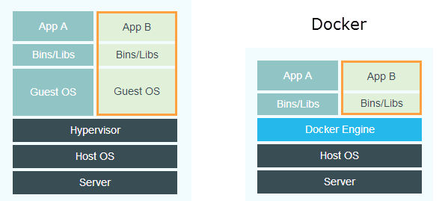
What is Docker
Notes:
Picture on left is VMs, picture on right is Docker instances

Slide 7
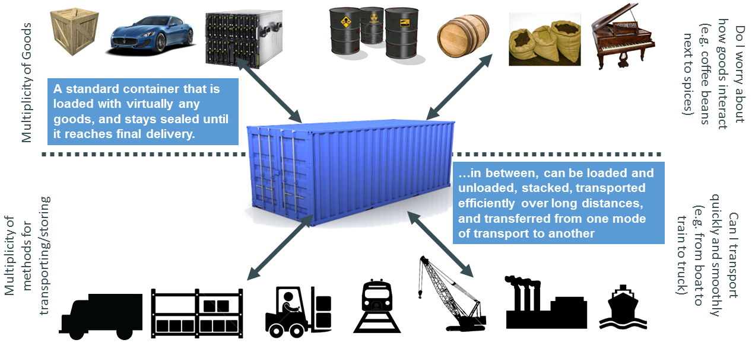
What is Docker
Notes:
Picture of how we use containers to ship different goods through different transportation methods

Slide 8
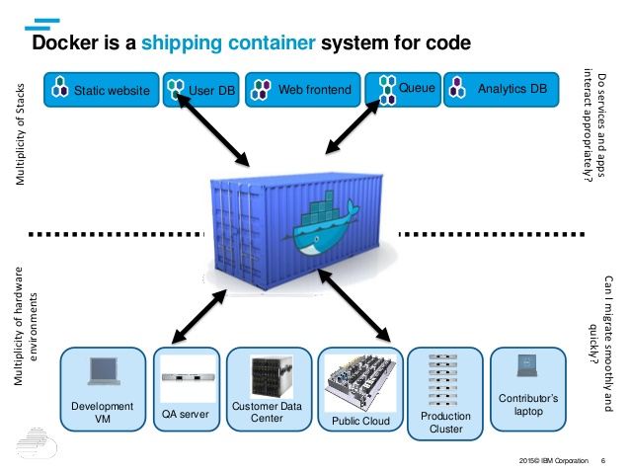
What is Docker
Notes:
Picture of Docker as a shipping container for code

Slide 9
Why Docker?
About 5 times more efficient than a VM
1 Windows license (for the host) covers all containers
Portability – consistent deployment
Security
Scanning of images
Signing of images

Slide 10
Docker for Windows
You will need Windows 10, and use Hyper-V
www.docker.com, follow links to developer section
After installation Docker commands available in shell
docker version
docker run hello-world

Slide 11
Docker for Windows
Choose your base image
microsoft/nanoserver
Preferred, most minimal environment
microsoft/windowsservercore
.NET Framework apps
MSI installers for apps and dependencies
32-bit runtime support
Or a derived image

Slide 12
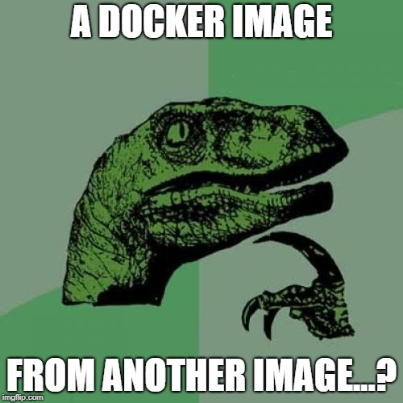
Docker for Windows

Slide 13
Docker for Windows
Derived images
microsoft/iis – basic Windows with IIS installed
microsoft/apsnet – ASP.NET installed on top of IIS
microsoft/aspnet:3.5 - .NET 3.5 installed and ASP.NET set up
openjdk – OpenJDK Java runtime installed
golang – Go runtime and SDK installed
microsoft/dotnet - .NET runtime and SDK installed

Slide 14

Docker for Windows

Slide 15
Our Simple Windows app
Visual C#, Web, ASP.NET Web Application, Single Page
OK, not that simple, more like a real app…(?)

Slide 16

Our Simple Windows app

Slide 17
Dockerize Windows app
Publish your app locally
Create a Dockerfile
Describe the steps taken to install the app
Build the image
Run the container

Slide 18

Dockerize the Windows app – Publish locally

Slide 19
Dockerize the Windows app – Publish locally
Create a publish profile to a local directory
Bin\Release\PublishOutput
Change settings
Precompile during publishing: yes
Publish app to PublishOutput

Slide 20
Dockerize Windows app - Dockerfile
Based on microsoft/aspnet
Windows Server Core
IIS
ASP.NET
Copy your published app into the /inetpub/wwwroot

Slide 21
Dockerize Windows app – Dockerfile
# The `FROM` instruction specifies the base image. You are
# extending the `microsoft/aspnet` image.
FROM microsoft/aspnet
# The final instruction copies the site you published earlier into the container.
COPY ./bin/Release/PublishOutput/ /inetpub/wwwroot
Notes:
There is no Entrypoint in this DockerFile. IIS process is the entrypoint, which is configured to start in the aspnet base image.

Slide 22
Dockerize Windows app – Build the image
docker build -t mvcrandomanswers .
REPOSITORY TAG IMAGE ID CREATED SIZE
mvcrandomanswers latest 86838648aab6 2 minutes ago 10.1 GB

Slide 23
Dockerize Windows app – Run the container
docker container run --detach --name randomanswers mvcrandomanswers
docker container inspect randomanswers

Slide 24
Dockerize Windows app – See the app
Notes:
Browse to IP address shown in Inspect

Slide 25

Dockerize Windows app – See the app

Slide 26

What’s next?
How about not relying on Visual Studio to build your code?

Slide 27
Let Docker container build
FROM microsoft/dotnet-framework:4.7.2-sdk as build
WORKDIR /app
#copy csproj and restore in distinct layers
COPY *.sln .
COPY MVCRandomAnswerGenerator/*.csproj ./MVCRandomAnswerGenerator/
COPY MVCRandomAnswerGenerator/*.config ./MVCRandomAnswerGenerator/
RUN nuget restore
# copy everything else and build app
COPY MVCRandomAnswerGenerator/. ./MVCRandomAnswerGenerator/
WORKDIR /app/MVCRandomAnswerGenerator
RUN msbuild /p:Configuration=Release
FROM microsoft/aspnet:4.7.2 AS runtime
WORKDIR /inetpub/wwwroot
COPY --from=build /app/MVCRandomAnswerGenerator/. ./

Slide 28
Run the result
docker run –d –p 80:80 –name myapp randomanswerbuild:latest
then
docker inspect myapp
or
docker exec –ti myapp powershell
ipconfig

Slide 29
OK, what else is next?
Turn this into a complete CI/CD chain
Deploy some (all?) of it on Azure
Learn more about containers
http://www.microsoft.com/containers
http://www.docker.com
http://www.katacoda.com/courses/docker
http://blog.sixeyed.com

Slide 30
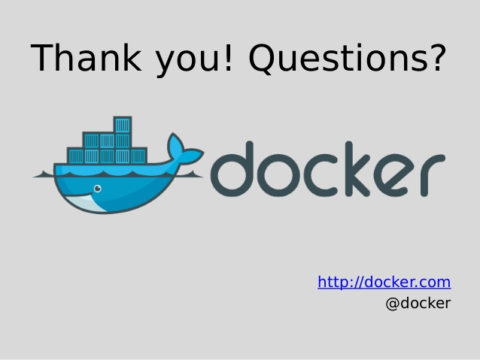

Slide 31
Contact info
Twitter: @ronaldb
http://automationadventures.com

